Slide 1
The Qur’an and the truth about Evolution
Marwan Boustany
2019

Slide 2

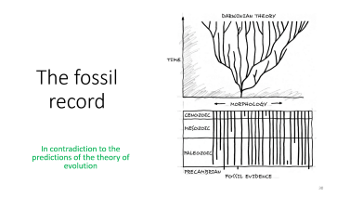
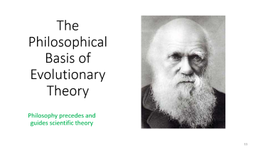
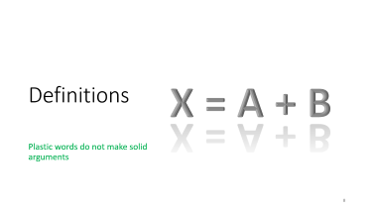

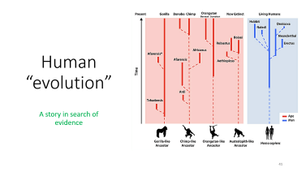
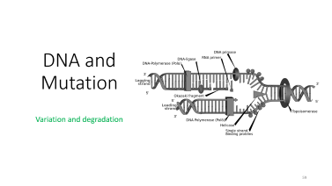





Slide 3

What Allah says
Creation and maintenance in a universe of ayaat

Slide 4
Allah’s Creation: Humans
وَلَقَدْ خَلَقْنَا الْإِنسَانَ مِن صَلْصَالٍ مِّنْ حَمَإٍ مَّسْنُونٍ
And We did certainly create mankind out of clay from an altered black mud.
(Qur’an 15:26)

Slide 5
Allah’s Creation: Humans and Animals
خَلَقَكُم مِّن نَّفْسٍ وَاحِدَةٍ ثُمَّ جَعَلَ مِنْهَا زَوْجَهَا وَأَنزَلَ لَكُم مِّنَ الْأَنْعَامِ ثَمَانِيَةَ أَزْوَاجٍ
He has created you from a single being, then made its mate of the same (kind), and He has sent down for you, of the livestock, eight pairs. …
(Qur’an 39:6)

Slide 6
Allah’s Creation: Humans and Animals
أَوَلَمْ يَرَوْا إِلَى الْأَرْضِ كَمْ أَنبَتْنَا فِيهَا مِن كُلِّ زَوْجٍ كَرِيمٍ
إِنَّ فِي ذَٰلِكَ لَآيَةً وَمَا كَانَ أَكْثَرُهُم مُّؤْمِنِينَ
Do they not look at the earth,- how many noble [living creations] of all kinds/groups/types We have produced/planted [and caused to grow] therein?
Most surely there is a sign in that, but most of them will not believe.
(Qur’an 26:7-8)
[Se also 43:12]

Slide 7
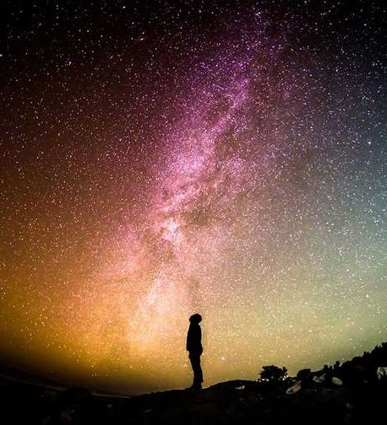
Ayaat of Allah are there for us to see and reflect upon
Indeed, in the creation of the heavens and the earth and the alternation of the night and the day are signs for those of understanding.
Who remember Allah while standing or sitting or [lying] on their sides and give thought to the creation of the heavens and the earth, [saying], "Our Lord, You did not create this aimlessly; exalted are You [above such a thing]; then protect us from the punishment of the Fire.
(Qur’an 3:190-191)

Slide 8
Definitions
X = A + B
Plastic words do not make solid arguments

Slide 9
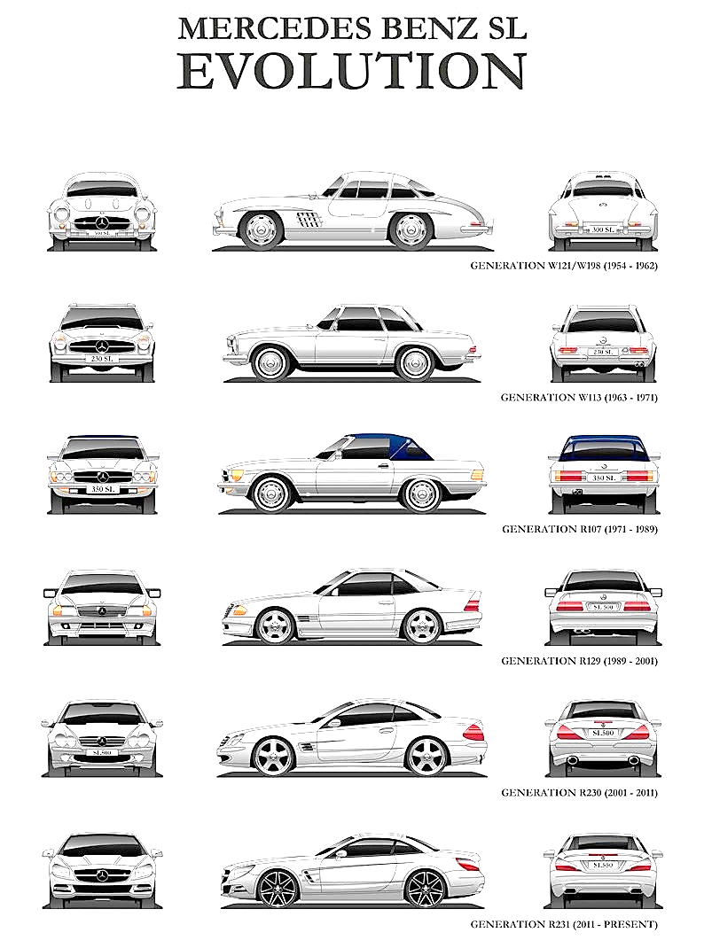
Trickery with definitions
In order to confuse people about the story of evolution, various meanings for the same word are used interchangeably:
Change over time
The process of variation seen within types of animals, e.g., fish, birds, humans [colours, sizes, shapes, etc.].
The process of universal common descent, from a cell to you.

Slide 10
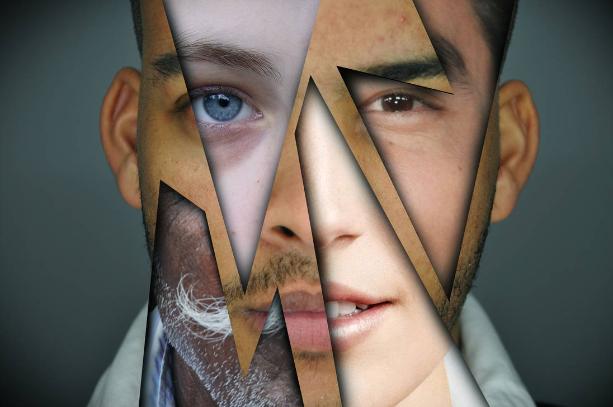
Trickery with definitions
In order to confuse people about the story of evolution, various meanings for the same word are used interchangeably:
Change over time
The process of variation seen within types of creatures, e.g., fish, birds, humans [colours, sizes, shapes, etc.].
The process of universal common descent, from a cell to you.
And of His signs is the creation of the heavens and the earth and the diversity of your languages and your colours. Indeed in that are signs for those of knowledge.
(Qur’an 30:22)
Notes:
See also (49:13) - O people, We created you from a male and female, and We made you into nations and tribes, that you may know one another. Surely, the most honourable among you in the sight of God is the most righteous. God is Knowledgeable, Aware.

Slide 11
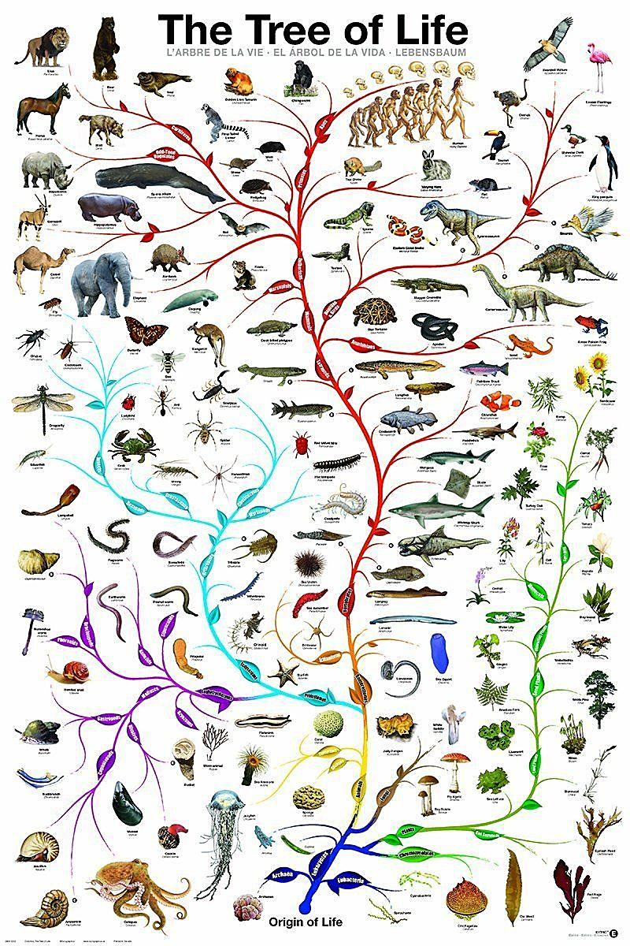
Trickery with definitions
In order to confuse people about the story of evolution, various meanings for the same word are used interchangeably:
Change over time
The process of variation seen within types of animals, e.g., fish, birds, humans [colours, sizes, shapes, etc.].
The process of universal common descent, from a cell to you.
This is actually what they are trying to make you believe

Slide 12
What is Evolution
In this talk ‘Evolution’ means:
All creatures are related through descent:
The idea that modern creatures are the products of earlier creatures in an unbroken chain back to the earliest life-forms.
How all creatures are related:
Random/unguided mutation.
“Natural selection”.

Slide 13
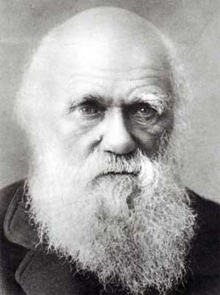
The Philosophical Basis of Evolutionary Theory
Philosophy precedes and guides scientific theory

Slide 14
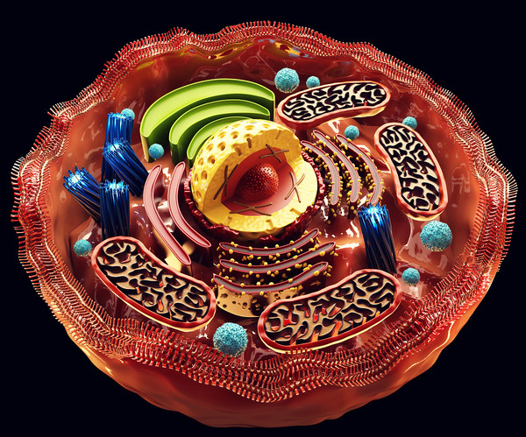
Hypothesis: A proposed explanation made on the basis of limited evidence as a starting point for further investigation.
How do we explain life?
Hypothesis
How do we explain life naturally?
Experiment
Designed or ‘natural’ processes?
Life
Only ‘natural’ processes.
Evidence
Interpretation of evidence
Conclusions
Philosophy
There is no Creator
Philosophy: Relating to the fundamental nature of knowledge, reality, and existence.

Slide 15

Hypothesis: A proposed explanation made on the basis of limited evidence as a starting point for further investigation.
How do we explain the body?
Hypothesis
How did the suicide happen?
Dead body with a stab wound
Experiment
Murder or suicide?
Definitely suicide.
Evidence
Interpretation of evidence
Conclusions
Philosophy
There is no murder
Philosophy: Relating to the fundamental nature of knowledge, reality, and existence.

Slide 16
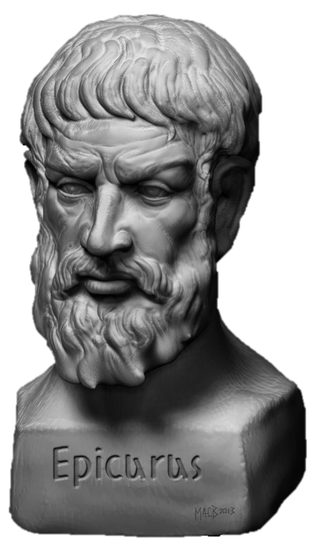
Materialistic philosophy
In a godless universe, evolution is true by definition

Slide 17
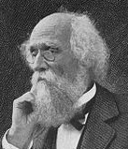
A commitment to materialism
“We are confident that evolution is absolutely certain — not evolution as a special theory — Lamarckian, Darwinian, Spencerian… but evolution as a law of derivation of forms from previous forms. In this sense it is not only certain, it is axiomatic …. The origins of new phenomena are often obscure, even inexplicable, but we never think to doubt that they have a natural cause; for so to doubt is to doubt the validity of reason, and the rational constitution of Nature.”
(Joseph Le Conte, Evolution, 1888)
Joseph Le Conte
Geologist and president of the American Association for the Advancement of Science in 1892
Axiomatic:
self-evident or unquestionable

Slide 18
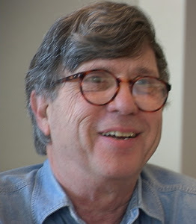
A commitment to materialism
“Our willingness to accept scientific claims that are against common sense is the key to an understanding of the real struggle between science and the supernatural.
We take the side of science in spite of the patent absurdity of some of its constructs, in spite of its failure to fulfill many of its extravagant promises of health and life, in spite of the tolerance of the scientific community for unsubstantiated just – so stories, because we have a prior commitment, a commitment to materialism.”
Cont’d next slide.
Richard Lewontin
Harvard University.
Evolutionary biologist, mathematician, geneticist. A leader in developing the mathematical basis of population genetics and evolutionary theory

Slide 19
A commitment to materialism
“It is not that the methods and institutions of science somehow compel us accept a material explanation of the phenomenal world, but, on the contrary, that we are forced by our a priori adherence to material causes to create an apparatus of investigation and a set of concepts that produce material explanations, no matter how counter-intuitive, no matter how mystifying to the uninitiated. Moreover, that materialism is absolute, so we cannot allow a Divine Foot in the door.”
(Richard Lewontin, Billions and billions of demons (review of The Demon-Haunted World: Science as a Candle in the Dark by Carl Sagan, 1997), The New York Review, p. 31, 9 January 1997. http://www.nybooks.com/articles/1997/01/09/billions-and-billions-of-demons/ )
Richard Lewontin
Harvard University.
Evolutionary biologist, mathematician, geneticist. A leader in developing the mathematical basis of population genetics and evolutionary theory
A priori: being without examination or analysis

Slide 20
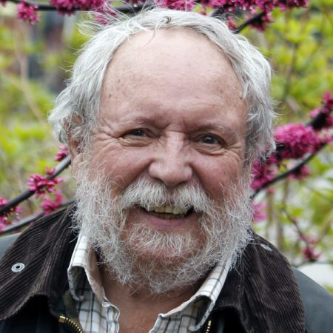
A secular religion
“With a growing number of distinguished evolutionists - including Ernst Mayr, Edward O. Wilson, and Francisco Ayala - I believe that Darwinism is more than just a scientific theory. It is the basis for a full world view, a Weltanschauung.”
(Michael Ruse, (1986): Taking Darwin seriously – A naturalistic approach to philosophy. New York, p. 513)
“[F]or many evolutionists, evolution has functioned as something with elements which are, let us say, akin to being a secular religion ... [A]t some very basic level, evolution as a scientific theory makes a commitment to a kind of naturalism, namely, that at some level one is going to exclude miracles and these sorts of things come what may.”
(Michael Ruse, "Nonliteralist Antievolution,"], AAAS Symposium: "The New Antievolutionism," February, 1993, Boston, MA., emphasis added)
Michael Ruse
Prominent philosopher of science and atheist

Slide 21
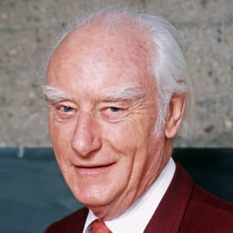
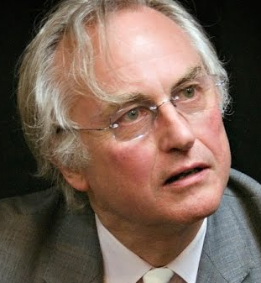
Intentional rejection of design/ayaat
"Biologists must constantly keep in mind that what they see was not designed, but rather evolved."
(Francis Crick, Co-discoverer of the structure of DNA, Nobel laureate 1962, professor at the Salk Institute, USA], "What Mad Pursuit: A Personal View of Scientific Discovery," 198, Penguin Books: London, 1990, reprint, p.138)
"Biology is the study of complicated things that give the appearance of having been designed for a purpose."
(Richard Dawkins, "The Blind Watchmaker," 198, Penguin: London, 1991, reprint, p.1).
“The feature of living matter that most demands explanation is that it is almost unimaginably complicated in directions that convey a powerful illusion of deliberate design.”
(Richard Dawkins, Zoologist and vocal atheist, “A Devil’s Chaplain” (2003), pg. 79, New York: Houghton Mifflin.)
Francis Crick
Nobel prize winning biologist and atheist.
Richard Dawkins
Oxford University.
Biologist and vocal atheist

Slide 22
Deniers blame illusion for their rejection
And We had certainly sent [messengers] before you, among the sects of the former peoples.
And no messenger would come to them except that they ridiculed him.
Thus do We insert denial into the hearts of the criminals.
They will not believe in it, while there has already occurred the precedent of the former peoples.
And [even] if We opened to them a gate from the heaven and they continued therein to ascend,
They would say, "Our eyes have only been clouded. Rather, we are a people affected by illusion/deception.”
(Qur’an 15:10-15)

Slide 23
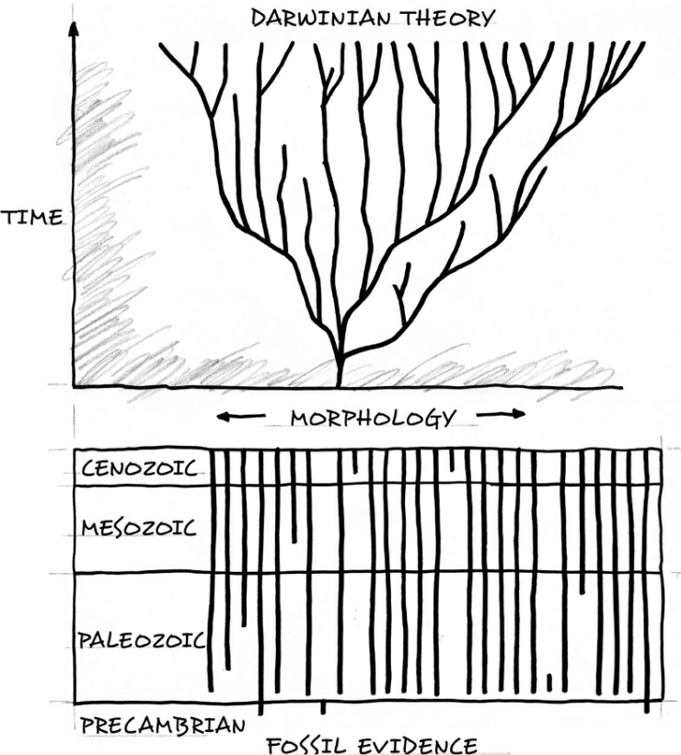
Intentional rejection of design/ayaat
“By now it should be clear why so many brilliant scientists have missed the evidence of design in the Cambrian explosion. Scott Todd, a biologist writing in Nature, succinctly stated the reason:
“Even if all the data point to an intelligent designer, such a hypothesis is excluded from science because it is not naturalistic.”
(Stephen C. Meyer, Darwin's Doubt: The Explosive Origin of Animal Life and the Case for Intelligent Design, 2014, (Kindle Locations 7517-7519). HarperCollins. Kindle Edition.)
Cambrian explosion:
About 530 million years ago, many major types of creatures came into existence abruptly.

Slide 24
Deniers refuse to see
I will turn away from My signs those who are arrogant upon the earth without right; and if they should see every sign, they will not believe in it. And if they see the right way, they will not adopt it as a way; but if they see the wrong way, they will adopt it as a way. That is because they have denied Our signs and they were heedless of them.
(Qur’an 7:146)

Slide 25
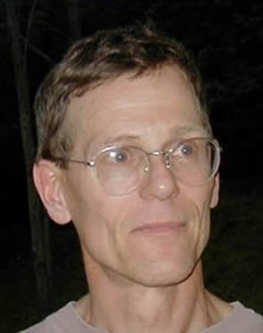
A philosophy that destroys humanity and faith
“Modern science directly implies that the world is organized strictly in accordance with mechanistic principles. There are no purposive principles whatsoever in nature. There are no gods and no designing forces that are rationally detectable...
Second, modern science directly implies that there are no inherent moral or ethical laws, no absolute guiding principles for human society.
Thirdly, human beings are marvellously complex machines. The individual human becomes an ethical person by means of two primary mechanisms: heredity and environmental influences. That is all there is.
Fourth, we must conclude that when we die, we die and that is the end of us...”
(William Provine, "Evolution and the Foundation of Ethics" appeared in MBL Science (a publication of the Marine Biological Laboratory at Woods Hole, Massachusetts), vol. 3, no. 1, pp. 25-29.)
William Provine
Cornell
Professor and American historian of science and of evolutionary biology and population genetics

Slide 26
Mere conjecture
Have you seen the one who worships his own vain desires? Allah has, knowing (him as such), left him astray, and sealed his hearing and his mind, and put a cover on his sight. Who, then, will guide him after Allah (has withdrawn Guidance)? Will you not then receive warning?
And they say: "What is there but our life in this world? We shall die and we live, and nothing but time can destroy us." But of that they have no knowledge: they merely conjecture:
(Qur’an 45:23-24)

Slide 27
When philosophy destroys origins science
Origins science refers to scientific speculation about how life and the universe originated and how the various parts of them originated.
The modern philosophy of origins science is: -
Science is the search for material causes for all phenomena, like animals, trees, the planet, the universe, the mind etc…
Before any evidence is analysed and any theories are tested, scientists eliminate Creation as an option.
The philosophy of modern origins science is to deny the creation of Allah even before the evidence is analysed.

Slide 28
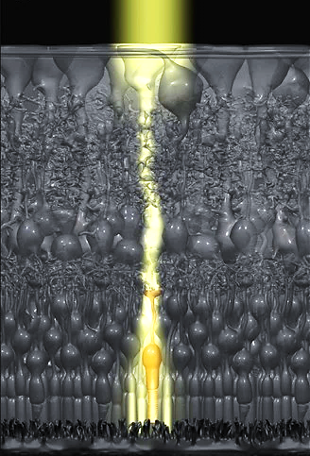
Theological speculation
‘Allah must design as we see fit’

Slide 29
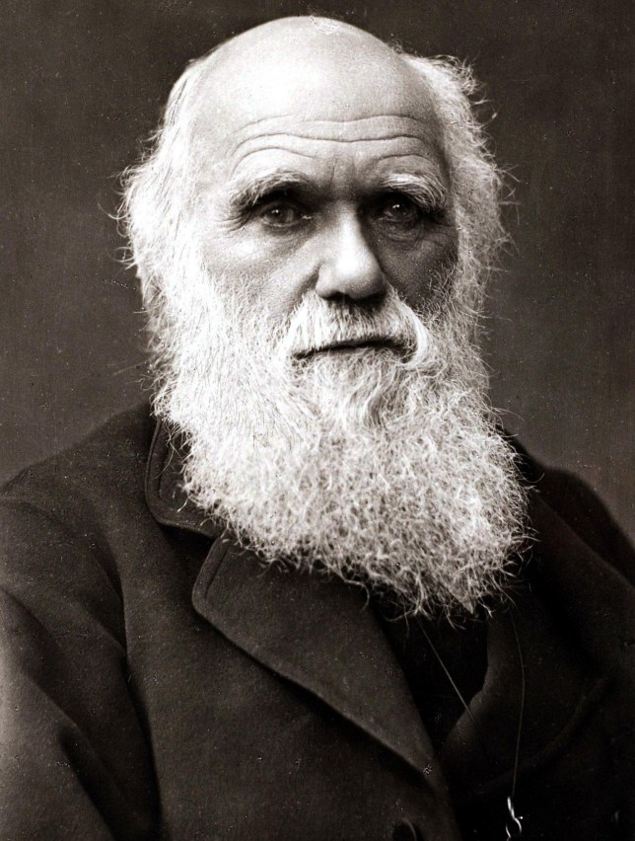
Darwin’s theological argumentation
“There seems to me too much misery in the world. I cannot persuade myself that a beneficent & omnipotent God would have designedly created the Ichneumonidae (a type of wasp) with the express intention of their feeding within the living bodies of caterpillars, or that a cat should play with mice. Not believing this, I see no necessity in the belief that the eye was expressly designed.”
(Charles Darwin, From a letter to Asa Gray, 22 May 1860) Bracketed words by me.
Charles Darwin
Evolutionist, materialist and storyteller
Notes:
“it may not be a logical deduction, but to my imagination it is far more satisfactory to look at such instincts as the young cuckoo ejecting its foster-brothers, – ants making slaves, – the larvae of ichneumonidae feeding within the live bodies of caterpillars, – not as specially endowed or created instincts, but as small consequences of one general law, leading to the advancement of all organic beings, namely, multiply, vary, let the strongest live and the weakest die.”
Charles Darwin, Origin of Species, London: John Murray, 1859, pp. 243–244

Slide 30
Darwin’s theological argumentation
“the existence of suffering” counts “against the existence of an intelligent ﬁrst cause” but “agrees well with the view that all organic beings have been developed through variation and natural selection”
(Charles Darwin, The Autobiography of Charles Darwin 1809–1882 (ed. Nora Barlow), New York: W.W. Norton & Co., 1958, pg. 90). Quoted in Stephen Dilley, Charles Darwin's use of theology in the Origin of Species, pg. 36.
Charles Darwin
Evolutionist, materialist and storyteller
Notes:
“The presence of so much pain and suffering in the world Darwin considered to be one of the strongest arguments against belief in a beneﬁcent God. But, he added, it accorded well with his theory of natural selection”
(John Brooke, Science and Religion, New York: Cambridge University Press, 1991, p. 316) Quoted in Stephen Dilley, Charles Darwin's use of theology in the Origin of Species, pg. 36-37.

Slide 31
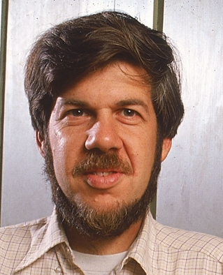
Modern theological arguments
Stephen Jay Gould.
Harvard University
Prominent evolutionist and palaeontologist
“Odd arrangements and funny solutions are the proof of evolution - paths that a sensible God would never tread but that a natural process, constrained by history, follows perforce.”
(Stephen Jay Gould, The Panda's Thumb (New York: W.W. Norton, 1980), pp. 20­-21)
“[I]mperfections are the primary proofs that evolution has occurred”
(Stephen Jay Gould, 1987, p 14. "The Panda's Thumb of Technology," Natural History, Vol. 96, No. 1, p 14-23)
“… perfection could be imposed by a wise creator or evolved by natural selection.”
(Stephen Jay Gould, p 122. "Evolution as Fact and Theory," in Montagu, 1984, p 117-125, originally published in Discover, May, 1981)
Imperfections can be subjective and are compatible with design.
Whether they observe perfection or [subjective] imperfection, it is taken as proof of evolution.
[Subjective] imperfection is taken as evidence against God and for evolution.
This is philosophy/theology, not scientific method.

Slide 32
Poor theological speculation
Assumptions are made about the completeness of the knowledge the scientist/person has.
Assumptions are made about what Allah would do.
These create expectations about what should be observed.
God wouldn’t do it that way!
When observation conflicts with expectation, they take it as proof against Allah.

Slide 33
Some key problems with evolution
Fossils:
The fossil record is in contradiction with the predictions/expectations of the theory.
Mutations and DNA:
What is observed about mutation is that it ultimately leads to degradation of DNA.
This is the opposite of what evolution needs.

Slide 34

The fossil record
In contradiction to the predictions of the theory of evolution

Slide 35
The structure of an explanation
An Explanation
Available tools/resources
What is to be explained
A theory or explanation for how something happens must clearly have the ability or resources to explain what is observed.
For evolution, just one of the things that is observed that must be explained is the fossil record. So lets look briefly at this.

Slide 36
Sudden origin of animals
"..why, if species have descended from other species by insensibly fine gradations, do we not everywhere see innumerable transitional forms? Why is not all nature in confusion instead of the species being, as we see them, well defined?" "... Why then is not every geological formation and every stratum full of such intermediate links? Geology assuredly does not reveal any such finely graduated organic chain; and this, perhaps, is the most obvious and gravest objection which can be urged against my theory."
(Charles Darwin (1859) The Origin of Species (Reprint of the first edition) Avenel Books, Crown Publishers, New York, 1979, p. 292)
Charles Darwin
Evolutionist, materialist and storyteller

Slide 37
Sudden origin of animals
“…in the case of contiguous geographical faunas, the change is apparently by substitution of one species for another, and not by transmutation of one species into another. So also in successive geological faunas, the change seems rather by substitution than by transmutation. In both cases species seem to come in suddenly, with all their specific characters perfect, remain substantially unchanged as long as they last, and then die out and are replaced by others. Certainly this looks much like immutability of specific forms, and supernaturalism of specific origin”
(Joseph Le Conte, Evolution, 1888)
Joseph Le Conte
Geologist and president of the American Association for the Advancement of Science in 1892

Slide 38
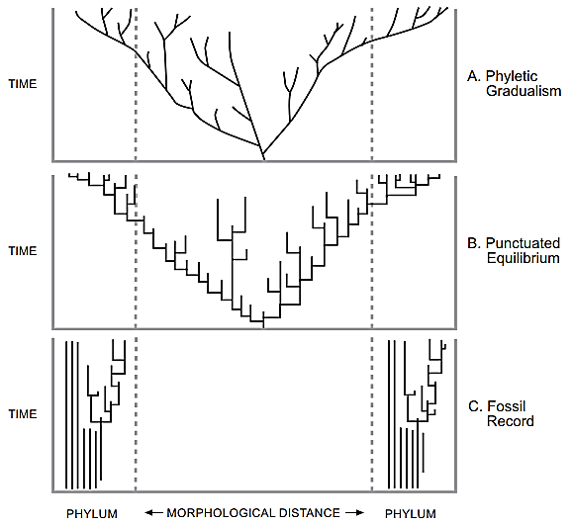
Sudden origin of animals
Stephen Jay Gould.
Harvard University
Prominent evolutionist and palaeontologist
"The history of most fossil species includes two features particularly inconsistent with gradualism:
Stasis. Most species exhibit no directional change during their tenure on earth. They appear in the fossil record looking much the same as when they disappear; morphological change is usually limited and directionless.
Sudden appearance. In any local area, a species does not arise gradually by the steady transformation of its ancestors; it appears all at once and `fully formed.’”
(Stephen J. Gould, Professor of Zoology and Geology, Harvard University, USA], "Evolution's Erratic Pace," Natural History, Vol. 86, No. 5, May 1977, p.14).
Stasis
Sudden appearance

Slide 39
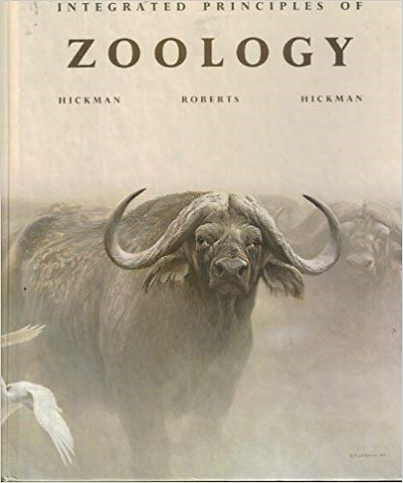
Sudden origin of animals
"Many species remain virtually unchanged for millions of years, then suddenly disappear to be replaced by a quite different, but related, form. Moreover, most major groups of animals appear abruptly in the fossil record, fully formed, and with no fossils yet discovered that form a transition from their parent group."
(C.P. Hickman, L.S. Roberts, and F.M. Hickman, Integrated Principles of Zoology, page 866 (Times Mirror/Moseby College Publishing, 1988, 8th ed)).
Integrated Principles of Zoology, 1988, 8th ed

Slide 40
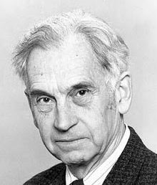
Sudden origin of animals
"Paleontologists had long been aware of a seeming contradiction between Darwin's postulate of gradualism, […], and the actual findings of paleontology. Following phyletic lines through time seemed to reveal only minimal gradual changes but no clear evidence for any change of a species into a different genus or for the gradual origin of an evolutionary novelty. Anything truly novel always seemed to appear quite abruptly in the fossil record."
(Ernst Mayr, Emeritus Professor of Zoology, Harvard University], "Toward a New Philosophy of Biology: Observations of an Evolutionist," Harvard University Press: Cambridge MA, 1988, pp.529-530).
Ernst Mayr.
One of the 20th century's leading evolutionary biologists. An architect of the modern evolutionary synthesis
Phyletic:
Referring to a line of descent

Slide 41
Sudden origin of animals
13 years later…
"Wherever we look at the living biota … discontinuities are overwhelmingly frequent…The discontinuities are even more striking in the fossil record. New species usually appear in the fossil record suddenly, not connected with their ancestors by a series of intermediates.“
(Ernst Mayr, What is Evolution, pg. 189 (2001).)
Ernst Mayr.
One of the 20th century's leading evolutionary biologists. An architect of the modern evolutionary synthesis
Biota:
Refers to all life on earth
Notes:
* a taxonomic superdomain including all life on Earth

Slide 42
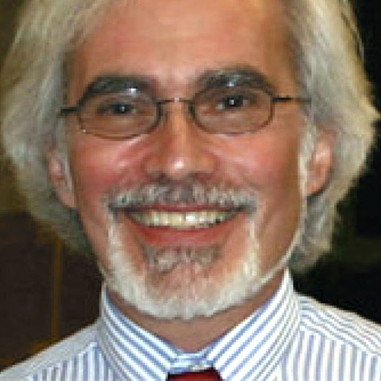
Sudden origin of animals
“The truth of the matter is that we are still in the dark about the origin of most major groups of organisms. They appear in the fossil record as Athena did from the head of Zeus – full blown and raring to go, in contradiction to Darwin’s depiction of evolution as resulting from the gradual accumulation of countless infinitesimally minute variations…”
(Jeffrey H. Schwartz, 1999. Sudden Origins: Fossils, Genes, and the Emergence of Species, p. 3.)
Jeffrey H. Schwartz.
Physical anthropologist and professor of biological anthropology

Slide 43
The evidence was there to see
أَوَلَمْ يَرَوْا إِلَى الْأَرْضِ كَمْ أَنبَتْنَا فِيهَا مِن كُلِّ زَوْجٍ كَرِيمٍ
إِنَّ فِي ذَٰلِكَ لَآيَةً وَمَا كَانَ أَكْثَرُهُم مُّؤْمِنِينَ
Do they not look at the earth,- how many noble [living creations] ^{A} of all kinds We have produced/planted ^{B} [and caused to grow] therein?
Most surely there is a sign in that, but most of them will not believe.
(Qur’an 26:7-8) [See also 43:12]
A: [زَوْجٍ] primarily signifies a thing of any kind [that is one of a pair or couple]. Also a sort of thing having its like, as in the case of species; and even types of people [56:7].
B: [أَنبَتْنَا], the root of this word is used in relation to planting/producing plants, animals and humans [71:17]. Also in relation to the growth of plants and humans [3:37] in the Qur’an.
Notes:
أَنبَتْنَا can be used with plants, animals and humans.

Slide 44
The fossils do not support evolution
"The extreme rarity of transitional forms in the fossil record persists as the trade secret of paleontology. The evolutionary trees that adorn our textbooks have data only at the tips and nodes of their branches; the rest is inference, however reasonable, not the evidence of fossils."
(Stephen J. Gould, Professor of Zoology and Geology, Harvard University, USA], "Evolution's erratic pace," Natural History, Vol. 86, No. 5, pp.12-16, May 1977, p. 14)
Stephen Jay Gould.
Harvard University
Prominent evolutionist and palaeontologist

Slide 45
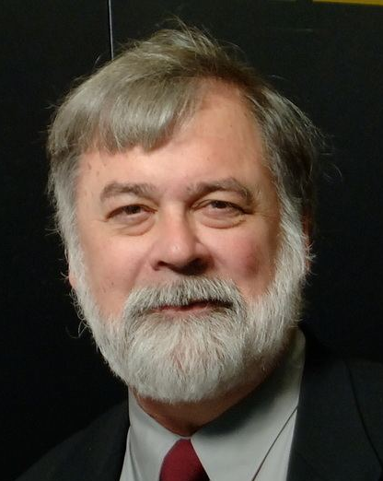
The fossils do not support evolution
"...we have proffered a collective tacit acceptance of the story of gradual adaptive change, a story that strengthened and became even more entrenched as the synthesis took hold. We paleontologists have said that the history of life supports that interpretation, all the while really knowing that it does not.”
(Niles Eldredge, Chairman and Curator of Invertebrates, American Museum of Natural History], "Time Frames: The Rethinking of Darwinian Evolution and the Theory of Punctuated Equilibria," Simon & Schuster: New York NY, 1985, p44)
Niles Eldredge.
Prominent evolutionist and palaeontologist

Slide 46
The fossils do not support evolution
"No wonder paleontologists shied away from evolution for so long. It never seemed to happen. … When we do see the introduction of evolutionary novelty, it usually shows up with a bang, and often with no firm evidence that the fossils did not evolve elsewhere! Evolution cannot forever be going on somewhere else. Yet that's how the fossil record has struck many a forlorn paleontologist looking to learn something about evolution."
(Niles Eldredge, Chairman and Curator of Invertebrates, American Museum of Natural History], 1995, Reinventing Darwin, Wiley, New York, p. 95)
Niles Eldredge.
Prominent evolutionist and palaeontologist

Slide 47
The fossils do not support evolution
“… the great majority of species appear with geological abruptness in the fossil record and then persist in stasis until their extinction. Anatomy may fluctuate through time, but the last remnants of a species usually look pretty much like the first representatives. Paleontologists have always recognized the long-term stability of most species, but we had become more than a bit ashamed by this strong and literal signal, for the dominant theory of our scientific culture told us to look for the opposite result of gradualism as the primary empirical expression of every biologist's favorite subject —evolution itself.”
(Stephen Jay Gould, The Structure of Evolutionary Theory (Cambridge: Harvard Univ Press, 2002), 749)
Stephen Jay Gould.
Harvard University
Prominent evolutionist and palaeontologist

Slide 48
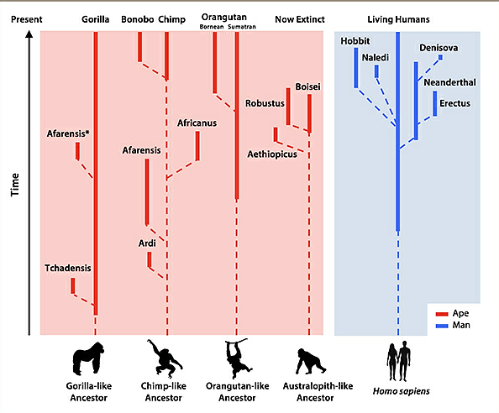
Human “evolution”
A story in search of evidence

Slide 49
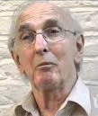
Philosophy comes before evidence
“Preconceived notions have played a fundamental role in the study of fossil man. Indeed, the science itself was not founded upon the evidence of fossils that needed explanation, but upon the notion that if mankind had evolved then fossils would provide the evidence of links between modern and ancestral forms. Thus scientists have sought evidence to prove an idea.”
(John Reader, Missing Links: The Hunt for Earliest Man, Penguin Books, 1990, p. xv)
John Reader.
Holds an Honorary Research Fellowship in the Department of Anthropology at University College London and is a fellow of the Royal Anthropological Institute.

Slide 50
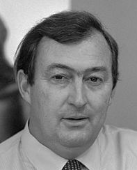
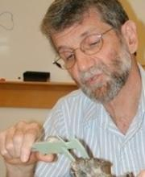
Little evidence, large claims
“Biologists would dearly like to know how modern apes, modern humans and the various ancestral hominids have evolved from a common ancestor. Unfortunately, the fossil record is somewhat incomplete as far as the hominids are concerned, …. David Pilbeam comments wryly, “If you brought in a smart scientist from another discipline and showed him the meagre evidence we’ve got he’d surely say, ‘forget it: there isn’t enough to go on’.””
(Richard E. Leakey, The Making of Mankind, E.P. Dutton, New York, p. 43, 1981.)
Richard E. Leakey
Recognised paleoanthro-
pologist and atheist
David Pilbeam: Professor of Human Evolution. Noted expert.
Hominid: Includes humans, chimpanzees, gorillas, and orangutans
Notes:
A hominid is any member of the biological family Hominidae. These are the "great apes", living and extinct. At present there are humans, chimpanzees, gorillas, and orangutans. The word "hominid" has been used in various ways. The classification of the great apes has been revised several times in the last few decades.

Slide 51
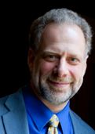
Little evidence, large claims
“Of the various transitions that occurred during human evolution, the transition from Australopithecus (ape like) to Homo (human like) was undoubtedly one of the most critical in its magnitude and consequences. As with many key evolutionary events, there is both good and bad news. First, the bad news is that many details of this transition are obscure because of the paucity of the fossil and archaeological records.”
(Harvard paleontologists Lieberman, Pilbeam, and Wrangham, “The Transition from Australopithecus to Homo,” Chapter 1, 2009.) Bracketed text is my addition.
Pilbeam.
Harvard. Professor of Human Evolution
Leiberman
Harvard.
Professor of Human Evolutionary Biology.
Notes:
"Of the various transitions that occurred during human evolution, the transition from Australopithecus to Homo was undoubtedly one of the most critical in its magnitude and consequences. As with many key evolutionary events, there is both good and bad news. First, the bad news is that many details of this transition are obscure because of the paucity of the fossil and archaeological records. ... But there is good news: although we lack many details about exactly how, when, and where the transition occurred from Australopithecus to Homo, we have sufficient data from before and after the transition to make some inferences about the overall nature of key changes that did occur between australopiths such as A. afarensis and unambiguous H. erectus." (Daniel E. Lieberman, David R. Pilbeam, and Richard W. Wrangham, “The Transition from Australopithecus to Homo,” in Transitions in Prehistory: Essays in Honor of Ofer Bar-Yosef, eds. John J. Shea and Daniel E. Lieberman (Cambridge: Oxbow Books, 2009), p. 1. )

Slide 52
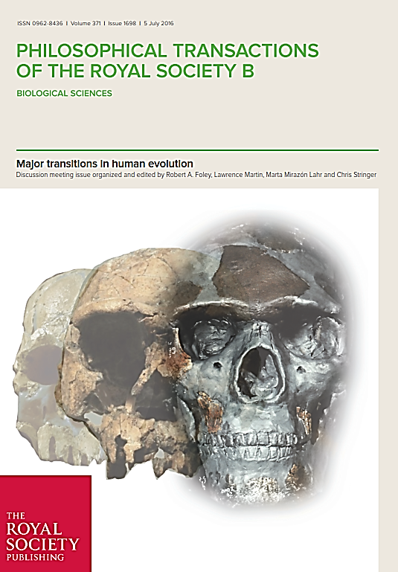
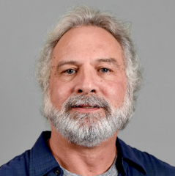
Little evidence, large claims
“Although the transition from Australopithecus to Homo is usually thought of as a momentous transformation, the fossil record bearing on the origin and earliest evolution of Homo is virtually undocumented”
“The origin and earliest evolution of the genus Homo perennially fascinate and frustrate in equal measure. Our fascination stems from the near-mythic qualities of uniqueness with which we tend to imbue the evolution of our lineage [4], whereas the frustration stems from critical gaps in the fossil record that actually bears on the first appearance of these features.”
(William H. Kimbel and Brian Villmoare, From Australopithecus to Homo: the transition that wasn’t. 2016. 371. Phil. Trans. R. Soc. B https://doi.org/10.1098/rstb.2015.0248)
William Kimbel
Centre Director & Professor:
The Institute of Human Origins. Arizona State U.

Slide 53
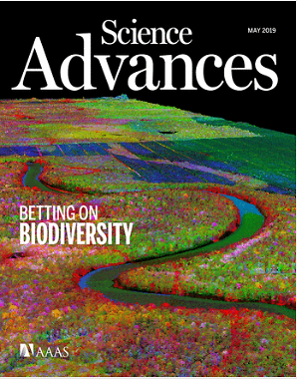
Little evidence, large claims
The issue of the origin of Homo is one of the thorniest questions in paleoanthropology and one that has led to myriad proposals and, sometimes, speculations. Answers to the questions of how, when, and where the earliest representatives of the genus emerged are still in flux, owing especially to the dearth of fossil data from the relevant temporal range (3.0 to 2.5 Ma ago). It is therefore important to use all available lines of evidence when addressing a question as data poor as this one.
(Temporal evidence shows Australopithecus sediba is unlikely to be the ancestor of Homo, 2019, [https://advances.sciencemag.org/content/5/5/eaav9038])

Slide 54
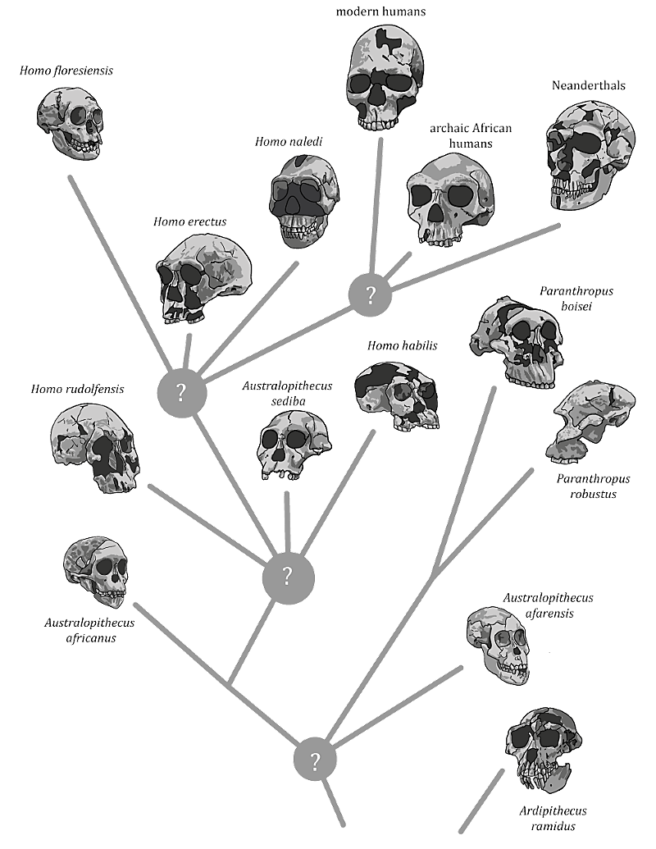
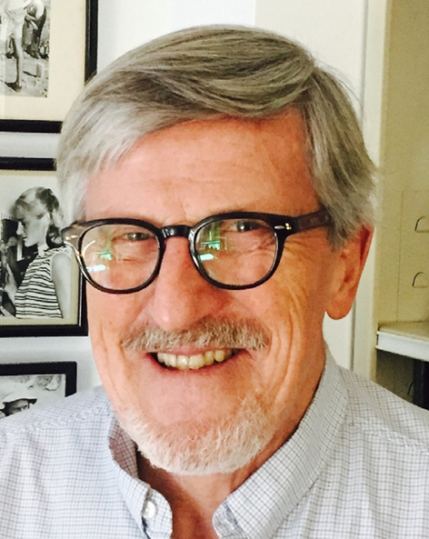
Continuing speculation
As of 2019
“Even with all the fossil evidence and analytical techniques from the past 50 years, a convincing hypothesis for the origin of Homo remains elusive.”
(Paleoanthropologist Bernard Wood of George Washington University. ‘Fifty Years after Homo habilis’, Nature 508:31-33, 2014)
Assumption
Bernard Wood. Prominent paleoanthropologist and professor of human evolution. Director of the Center for the Advanced Study of Human Paleobiology
https://medium.com/@johnhawks/three-big-insights-into-our-african-origins-3fa01eb5f03

Slide 55
A historical narrative, not evidence
“The earliest fossils of Homo, Homo rudolfensis and Homo erectus, are separated from Australopithecus by a large, unbridged gap. How can we explain this seeming saltation? Not having any fossils that can serve as missing links, we have to fall back on the time-honored method of historical science, the construction of a historical narrative.”
(Ernst Mayr, What Makes Biology Unique?: Considerations on the Autonomy of a Scientific Discipline(Cambridge: Cambridge University Press, 2004), 198.)
Ernst Mayr.
One of the 20th century's leading evolutionary biologists. An architect of the modern evolutionary synthesis

Slide 56
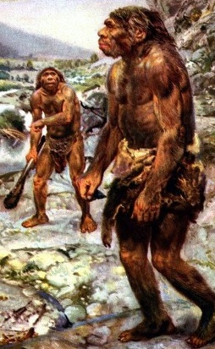
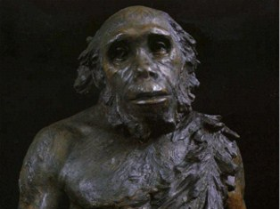
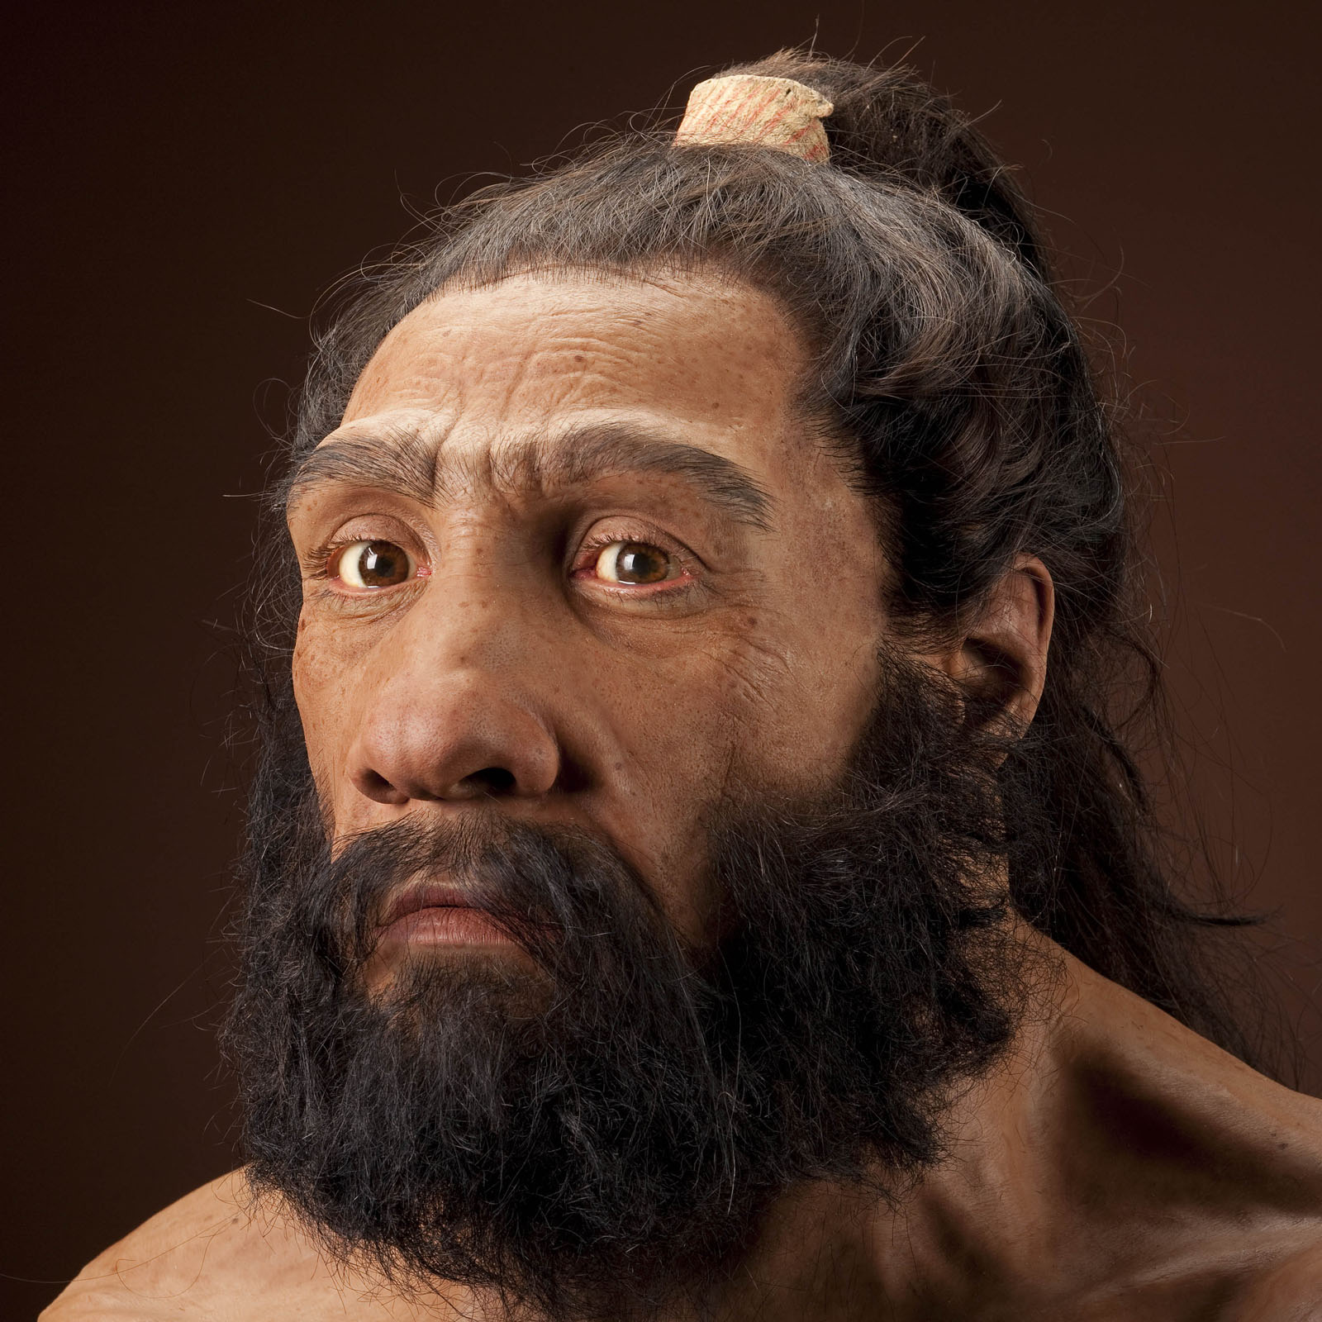

Neanderthals: Subhuman deception
1960s
“In the minds of the European anthropologists who first studied them, Neanderthals were the embodiment of primitive humans, subhumans if you will,” says Fred H. Smith, …. “They were believed to be scavengers who made primitive tools and were incapable of language or symbolic thought.” Now, he says, researchers believe that Neanderthals “were highly intelligent, … and capable of developing highly functional tools …. They were quite accomplished.”
(Joe Alper, “Rethinking Neanderthals,” Smithsonian magazine (June, 2003), accessed March 5, 2012, http://www.smithsonianmag.com/science-nature/neanderthals.html.)
1910
After 2000
After 2000

Slide 57
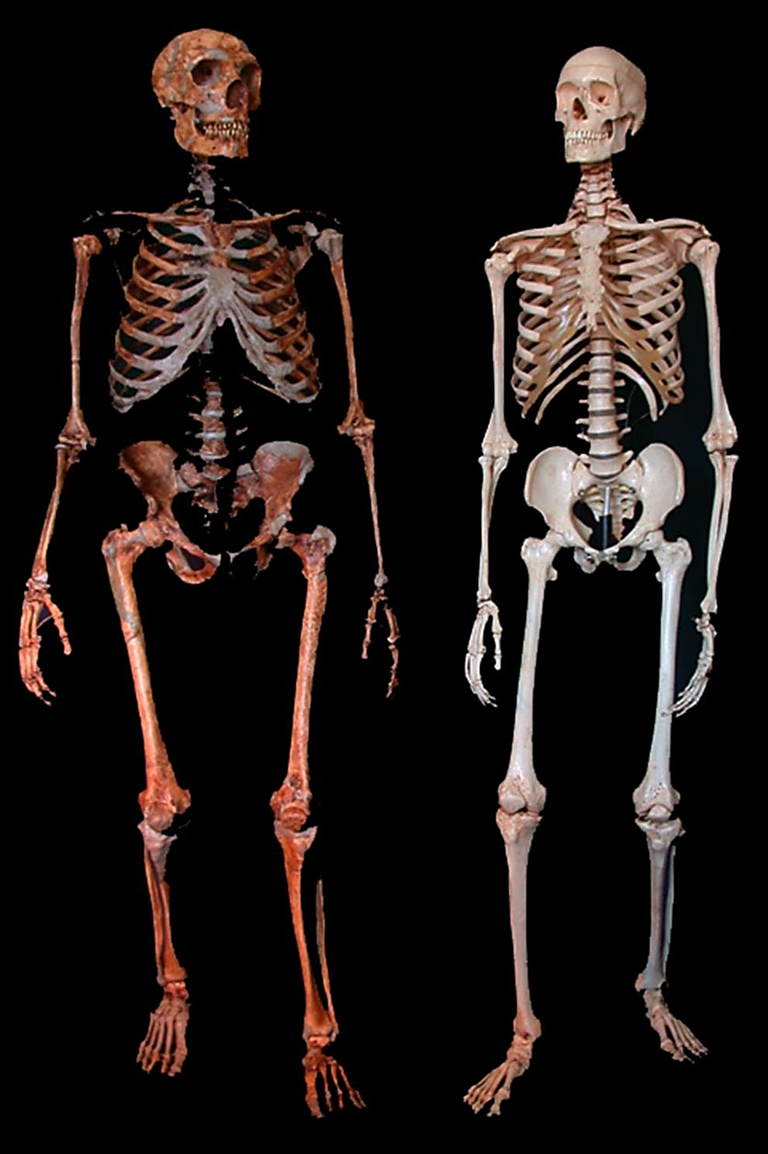
Neanderthals: Subhuman deception
“A new body of research has emerged that’s transformed our image of Neanderthals. … we now know that Neanderthals not only had bigger brains than sapiens, but also walked upright and had a greater lung capacity. These ice age Eurasians were skilled toolmakers and big-game hunters who lived in large social groups, built shelters, traded jewelry, wore clothing, ate plants and cooked them, …. Evidence is mounting that Neanderthals had a complex language and even, given the care with which they buried their dead, some form of spirituality.”
(Franz Lidz, “What Do We Really Know About Neanderthals?” at Smithsonian Magazine, accessed 20/04/2019.)

Slide 58
Summary
The theory of evolution is a historical theory of biology, it seeks to explain how all life came to be.
It was always its burden to explain the observed pattern of historical life. And the physical evidence for this is the fossil record.
Evolutionists have themselves recognised that the fossil record does not and never did align with what the theory expected [gradualism].
If the evidence was not on their side, why did they proclaim the absolute truth of their theory?
Materialistic philosophy. They are forced to accept the theory no matter the evidence.

Slide 59
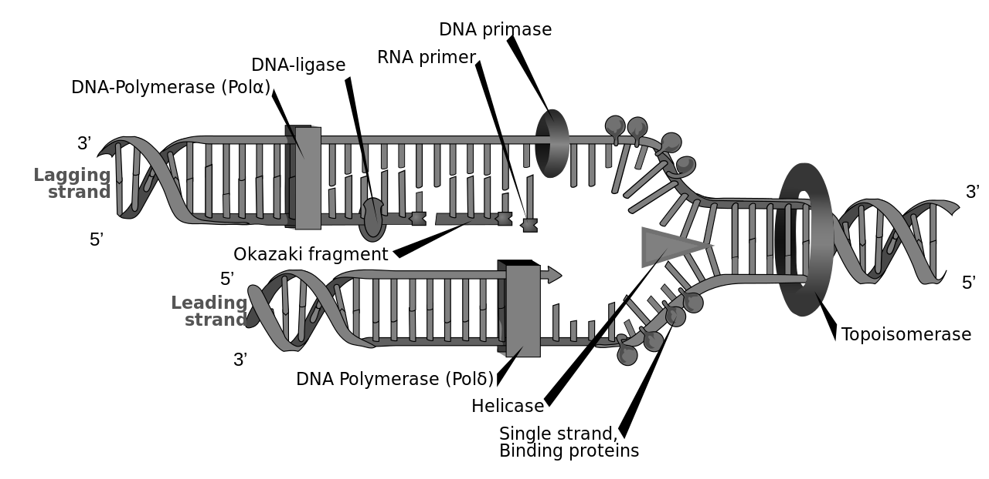
DNA and Mutation
Variation and degradation

Slide 60
The structure of an explanation
An Explanation
Available tools/resources
What is to be explained
A theory or explanation for how something happens must clearly have the ability or resources to explain what is observed.
For evolution, the resource to explain what is observed is mutation and natural selection, so lets look a bit a this.

Slide 61
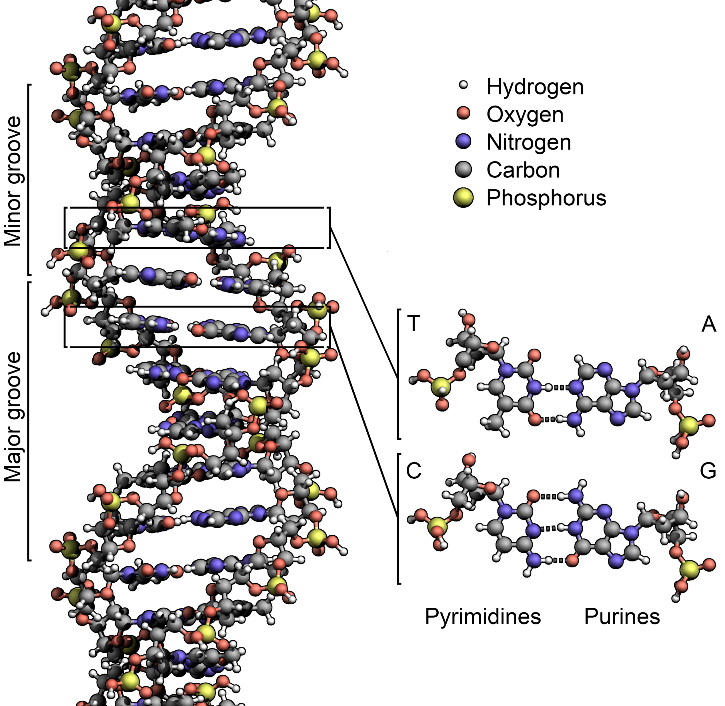
A living library and Operating system in a cell
DNA is a highly complex and dynamic information storage and processing tool found [initially] in every cell. It does the following:
It helps to store information about all the building blocks needed to make every protein/cell in your body.
It helps to store information on when to use the building blocks.
It helps to store information on how to use the building blocks.
DNA is an operating system that the cells run.

Slide 62
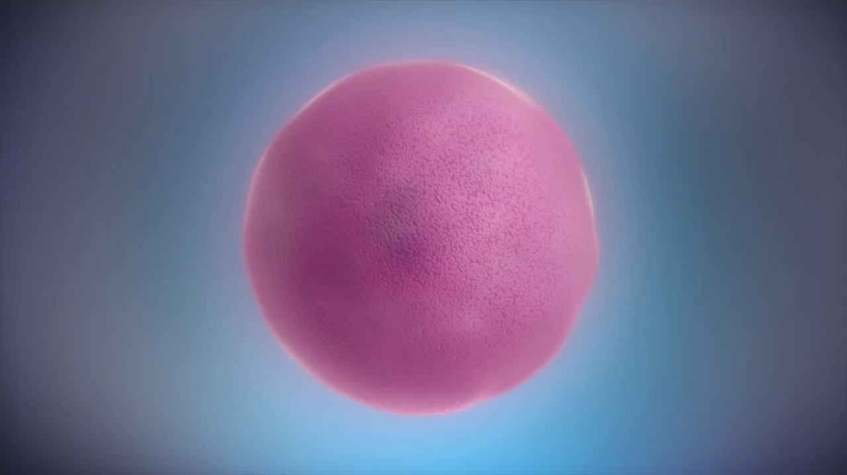

Slide 63
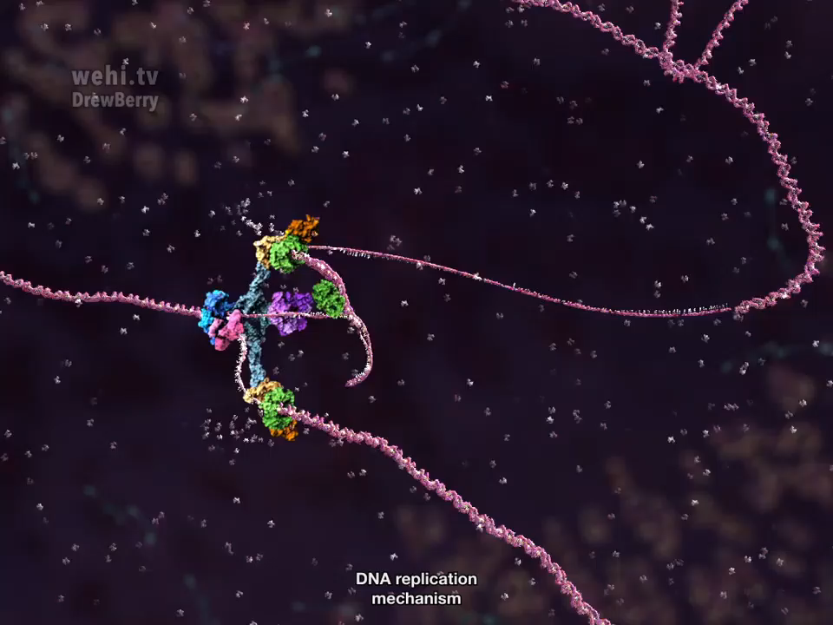

Slide 64
DNA and evolution: What is observed
In order for the theory of evolution to be true, mutations [of many kinds] must be able to create lots of new information and integrate it into the operating system of the cell. Challenges to this include:
Multiple overlapping codes.
Multiple codes from one gene.
Accumulation of negative mutations.
Long term biological variation is associated with genetic degradation.
Almost all of your DNA has purpose and function.

Slide 65
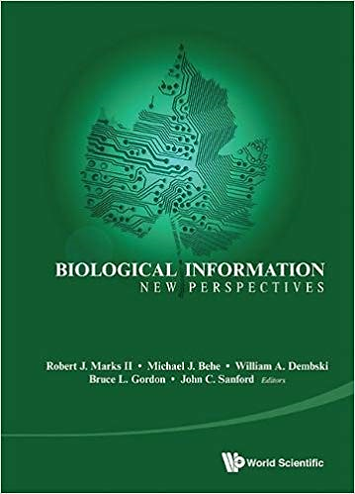
Overlapping codes
Nucleotide: A letter of genetic information
“The ENCODE project has confirmed that this phenomenon (overlapping codes) is ubiquitous in higher genomes, wherein a given DNA sequence routinely encodes multiple overlapping messages, meaning that a single nucleotide can contribute to two or more genetic codes. Most recently, Itzkovitz et al. analyzed protein coding regions of 700 species, and showed that virtually all forms of life have extensive overlapping information in their genomes.”
(Marks II, Robert J; Michael J Behe; William A Dembski; Bruce L Gordon; John C Sanford. Biological Information: New Perspectives - Proceedings of the Symposium (p. 141). World Scientific. Kindle Edition.) Bracketed words added by me

Slide 66
Overlapping codes
Sample code sequence of 40 bases
Various codes that use a subset of the code sequence
Overlap code sequence
Notes:
A model nucleotide sequence of 40 bases that encodes 6 partially overlapping codes. Each sub-section represents the positions of the Genome Section that participate in that particular code. For example, 19 positions of the Genome Section participate in Code 1 whereas all except the last 2 positions of the Genome Section participate in Code 6. Nucleotide positions of the Genome Section that do not fall into any code are considered entirely neutral with respect to those codes, since they play no part in what the function of those codes may be. In that regard, these neutral positions are not part of the functional genome (at least with respect to those specific codes).

Slide 67
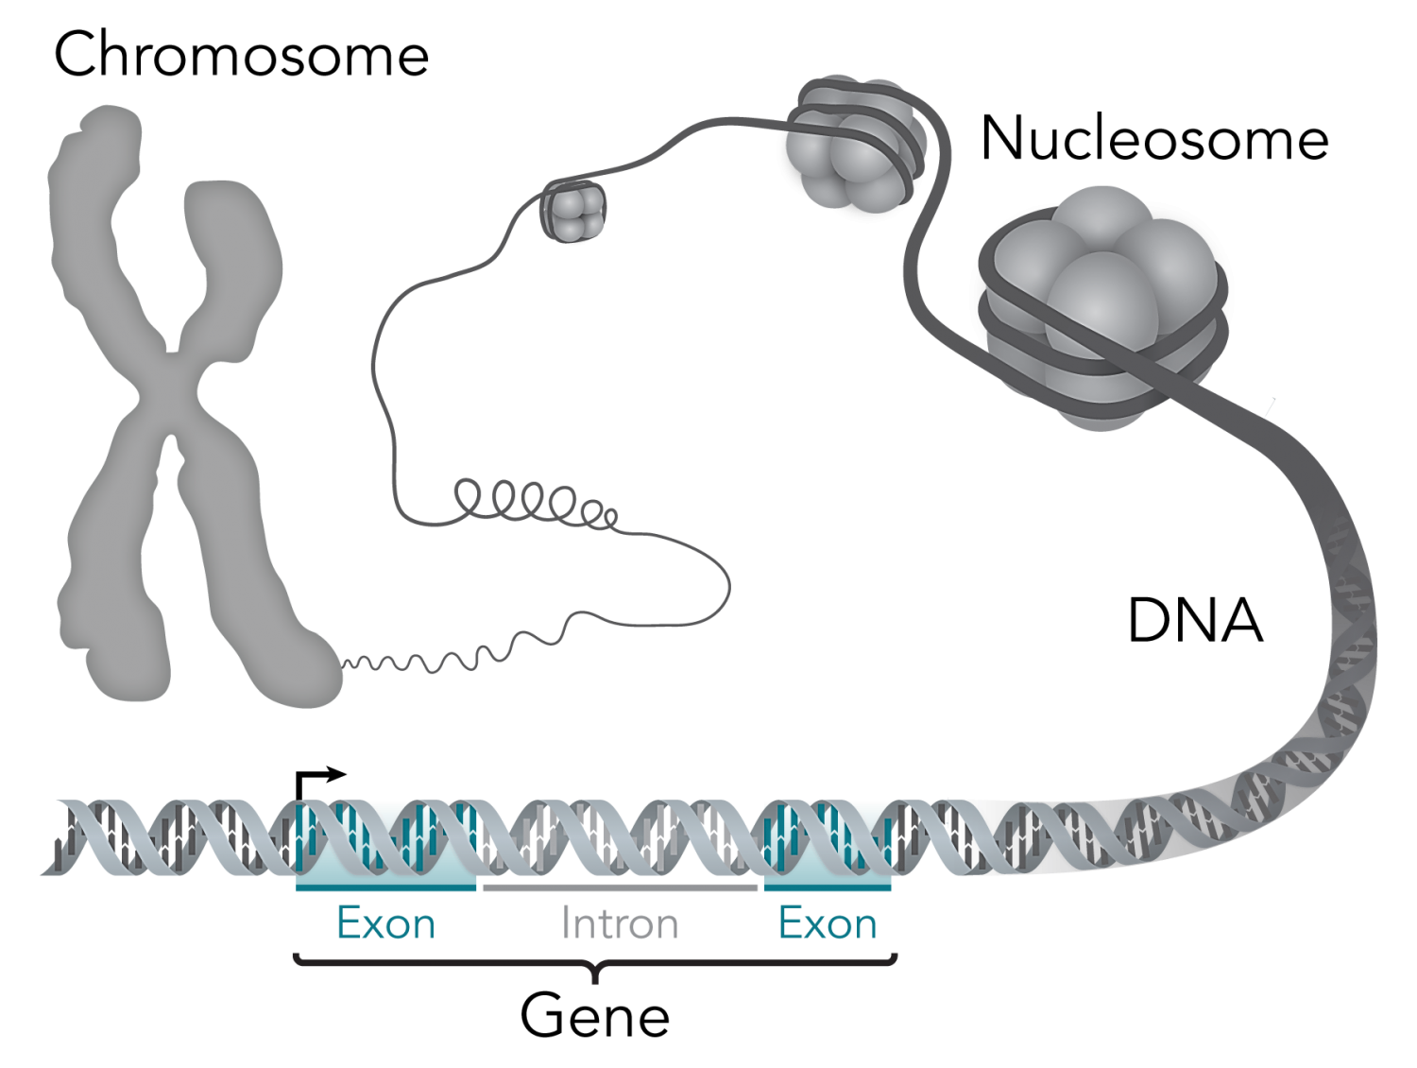
One code, many products
“WHEN A EUKARYOTIC GENE IS TRANSCRIBED (copied) INTO RNA, ITS INTRONS as well as its exons are included in the transcript, so the initial RNA transcript consists of protein-coding segments separated by non-protein-coding segments. The latter are removed, and the protein-coding segments are then spliced together before being translated into protein. In the great majority of cases (80–95%), the protein-coding segments can be “alternatively spliced,” which means that the resulting transcripts can lack some exons or contain duplicates of others. In this way, a single gene can give rise to hundreds—or even thousands—of different proteins.”
(Wells Ph.D., Jonathan. The Myth of Junk DNA . Discovery Institute Press. Kindle Edition.) Bracketed text is mine.
Intron: Non protein coding
Exon: Protein coding

Slide 68
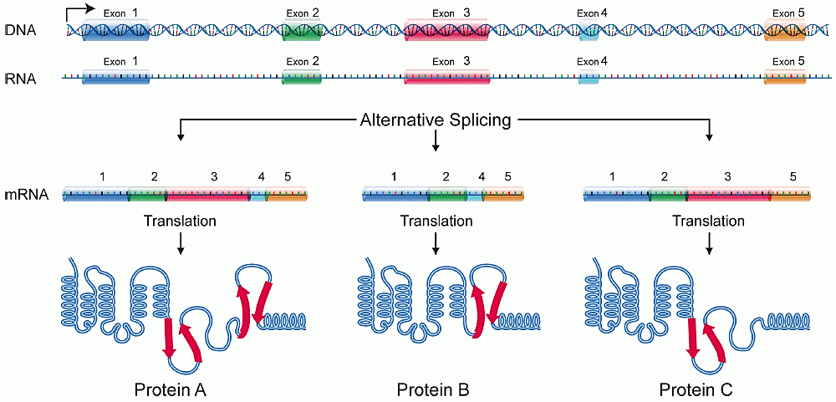
The splicing code
Intron
Intron
Intron
Intron

Slide 69
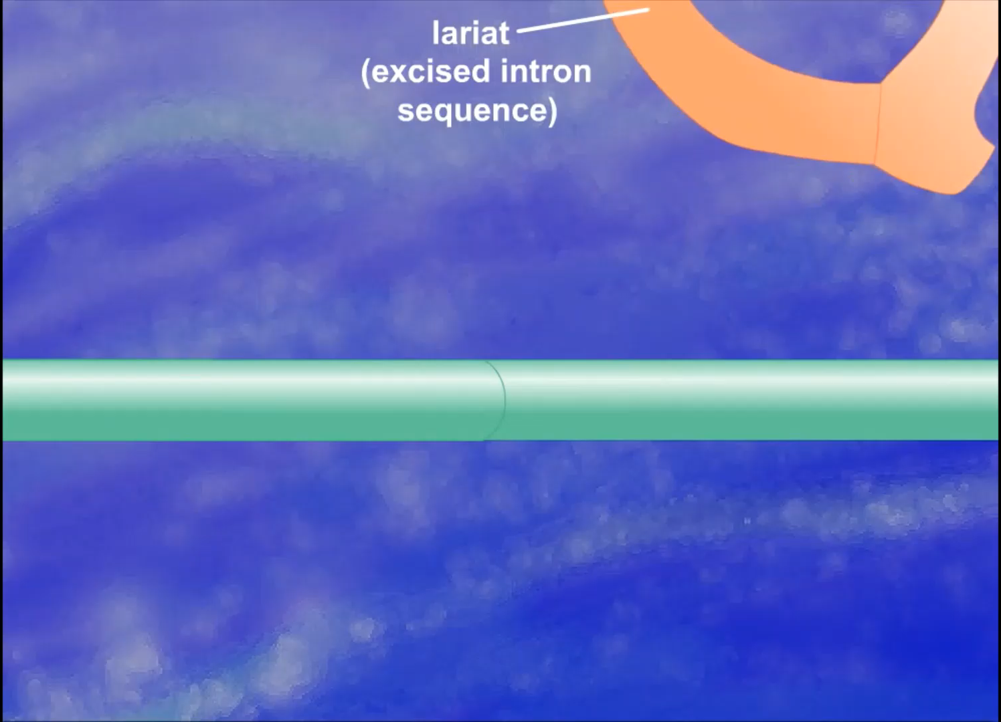
Notes:
An interesting update here is that it is now suspected we only have 20,000 genes.

Slide 70

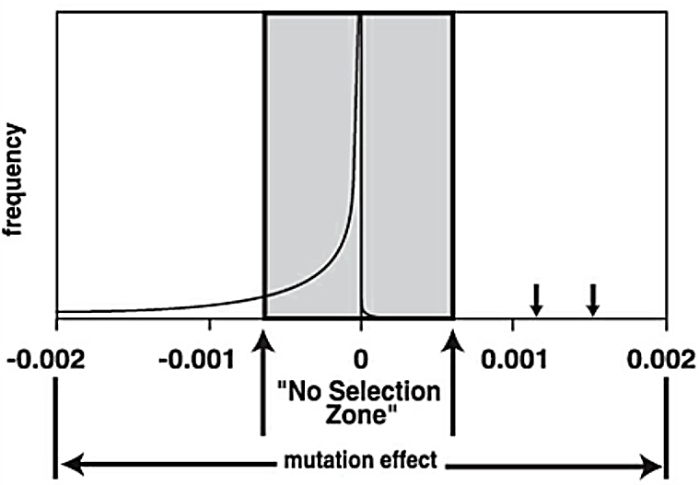
Mutations: Degradation not evolution
“One of the most astounding recent findings in the world of genetics is that the human mutation rate (just within our reproductive cells) is in the range of 75-175 nucleotide substitutions (misspellings) per person per generation. (Nachman and Crowell, 2000; Kondrashov, 2002; Xue et al., 2009; Lynch, 2010; Campbell and Eichler, 2013). ”
“Everything about the true distribution of mutations argues against mutations leading to a net gain in information, as needed for forward evolution.”
(John Sanford, Genetic Entropy . FMS Publications. Kindle Edition.)
John Sanford
Cornel University Professor, Plant geneticist and inventor of genetic delivery systems
Negative mutation distribution
‘Beneficial’ mutation distribution
Rare ‘beneficial’ mutations
Notes:
Figure: To complete the figure we really must show where the beneficial mutations would occur, as they are critical to evolutionary theory. Their distribution would be a reverse image of Kimura’s curve, but reduced in range and scale, by a factor of somewhere between one thousand to one million. Because of the scale of this diagram, I cannot draw this part of the mutation distribution small enough, so a relatively large curve is shown instead. Even with beneficial mutations greatly exaggerated, it becomes obvious that essentially all beneficial mutations will fall within Kimura’s “no-selection zone”. This completed picture, which is correct, makes progressive evolution on the genomic level virtually impossible. Adaptation to a special circumstance can still happen, due to extremely rare high-impact beneficials – which are isolated anomalies (shown by arrows to the right of the “no-selection zone”). These rare beneficial mutations almost always involve loss of function and are therefore unproductive in terms of “forward evolution”.
Sanford, John. Genetic Entropy . FMS Publications. Kindle Edition.

Slide 71

Mutations: Variation and degradation
“It’s been known for a long time that the great majority of mutations that have a measurable effect on a creature’s welfare are harmful. The amazing but in retrospect unsurprising fact established by the diligent work of many investigators in laboratory evolution over decades is that the great majority of even beneficial positively selected mutations damage an organism’s genetic information—either degrading or outright destroying functional coded elements.”
(Michael J.Behe, Darwin Devolves (p. 183). HarperOne. Kindle Edition.)
Michael J.Behe
Professor of biochemistry and a key figure in the Intelligent Design movement.

Slide 72

DNA is functional to a high degree
“The (Encode) Project concluded that 80% of the genome is linked to biological functions, but Project Coordinator Ewan Birney pointed out that this conclusion was based on analyses of only 147 cell types, and “the human body has a few thousand.” As more cell types are studied, Birney said, “It’s likely that 80 percent will go to 100 percent.””
(Marks II, Robert J; Michael J Behe; William A Dembski; Bruce L Gordon; John C Sanford. Biological Information: New Perspectives - Proceedings of the Symposium (p. 221). World Scientific. Kindle Edition.)
In September 2012, the Encode project published 37 papers in Nature, Genome Research, Genome Biology, The Journal of Biological Chemistry and Science.

Slide 73

The implication of functional DNA
“If the human genome is indeed devoid of junk DNA as implied by the ENCODE project, then a long, undirected evolutionary process cannot explain the human genome. If, on the other hand, organisms are designed, then all DNA, or as much as possible, is expected to exhibit function. If ENCODE is right, then Evolution is wrong.”
(Dan Graur, a presentation given at the 2013 meeting of the Society for Molecular Biology and Evolution in Chicago)
Dan Graur.
Prominent evolutionist, atheist and Professor of molecular evolution

Slide 74
DNA and evolution: What is to be explained
Multiple overlapping codes and multiple codes from one gene.
These facts [among others] mean that every random change made in DNA can impact numerous protein products and systems. This dramatically reduces the probability of beneficial mutations that increase the information in DNA.
Accumulation of negative mutations is inevitable and much variation in animals comes from degrading information.
These facts mean that over time, the direction of change is most likely toward genetic degradation. The opposite of what evolutionary theory needs.
Almost all of your DNA has purpose and function.
This means that there is nowhere known to be safe for mutations to accumulate in DNA. The engine of evolution has nowhere to run.

Slide 75


Evolutionists recognise the problem
“For more than half a century it has been accepted that new genetic information is mostly derived from random‚ error-based’ events. Now it is recognized that errors cannot explain genetic novelty and complexity.”
(The conference organizers)

Slide 76
Summary
The book of life is a magnificently written and designed work.
Its many complexities and designs layer on top of each other to produce a deafening chorus: ‘I was written by the author of all things’.
Evolutionists want you to accept that an accumulation of accidents, combined with time and circumstance, is the explanation for a dynamic and information rich library.
Reject their philosophy of materialism, and you have no basis to give their speculation any credence.

Slide 77

Philosophy masquerading as unfalsifiable “science”
“The central illusion of evolution lies in making a wide array of contradictory mechanisms look like a seamless whole. There is no single evolutionary mechanism - there are countless. Evolutionary theory is a smorgasbord: a vast buffet of disjointed and conflicting mechanisms waiting to be chosen by the theorist. For any given question, the theorist invokes only those mechanisms that look most satisfying. Yet, the next question elicits a different response, with other mechanisms invoked and neglected.”
(Walter Remine, The Biotic Message, pg. 24)

Slide 78
Philosophy masquerading as unfalsifiable “science”
“Evolutionary theory has no coherent structure. It is amorphous. It is malleable and can readily adjust to disparate patterns of data. Evolution accommodates data like fog accommodates landscape. In fact, evolutionary theory fails to-clearly predict anything about life that is actually true.”
(Walter Remine, The Biotic Message, pg. 24)

Slide 79

Philosophy masquerading as unfalsifiable “science”
“Being an evolutionist means there is no bad news. If new species appear abruptly in the fossil record, that just means evolution operates in spurts. If species then persist for eons with little modification, that just means evolution takes long breaks. If clever mechanisms are discovered in biology, that just means evolution is smarter than we imagined. If strikingly similar designs are found in distant species, that just means evolution repeats itself. … If no likely mechanism can be found for the large-scale change evolution requires, that just means evolution is mysterious. If adaptation responds to environmental signals, that just means evolution has more foresight than was thought. If major predictions of evolution are found to be false, that just means evolution is more complex than we thought.”
(Cornelius Hunter, Darwin’s God, Arsenic-Based Biochemistry: Turning Poison Into Wine)
Cornelius Hunter
Ph.D. in Biophysics and Computational Biology from the University of Illinois

Slide 80

Protect the natural inclination of Children
Children naturally believe in design and a designer.

Slide 81
Born with the knowledge
وَإِذْ أَخَذَ رَبُّكَ مِن بَنِي آدَمَ مِن ظُهُورِهِمْ ذُرِّيَّتَهُمْ وَأَشْهَدَهُمْ عَلَىٰ أَنفُسِهِمْ أَلَسْتُ بِرَبِّكُمْ قَالُوا بَلَىٰ شَهِدْنَا أَن تَقُولُوا يَوْمَ الْقِيَامَةِ إِنَّا كُنَّا عَنْ هَـٰذَا غَافِلِينَ
And whenever your Lord takes the offspring from the backs of the children of Adam, He calls upon them to bear witness about themselves: "Am I not your Lord?" - to which they answer: "Yes, indeed, we do bear witness!" [Of this We remind you,] lest you say on the Day of Resurrection, “Truly, we were unaware of this"
(Qur’an 7:172)

Slide 82

We are made to recognise the ayaat of Allah
“Drawing upon research in developmental psychology, cognitive anthropology and particularly the cognitive science of religion, I argue that religion comes nearly as naturally to us as language. The vast majority of humans are “born believers”, naturally inclined to find religious claims and explanations attractive and easily acquired, and to attain fluency in using them.”
(Justin L. Barrett, professor of developmental science at Fuller Theological Seminary School of Psychology.) 1
Justin L. Barrett
Experimental psychologist, Director of the Thrive Center for Human Development in Pasadena, California

Slide 83
We are made to recognise the ayaat of Allah
“Children tend to see natural objects as designed or purposeful in ways that go beyond what their parents teach.”
“Children doubt that impersonal processes can create order or purpose. Studies with children show that they expect that someone not something is behind natural order. No wonder that Margaret Evans found that children younger than 10 favoured creationist accounts of the origins of animals over evolutionary accounts even when their parents and teachers endorsed evolution. Authorities' testimony didn't carry enough weight to over-ride a natural tendency.”
(Justin L. Barrett, professor of developmental science at Fuller Theological Seminary School of Psychology.) 1/2
Justin L. Barrett
Experimental psychologist, Director of the Thrive Center for Human Development in Pasadena, California

Slide 84







What can you do? Be aware.
www.evolutionnews.org

